Slide 1
SOLAR HEATING
SOLAR ENERGY IS THAT RENEWABLE ENEGRGY
PRODUCED BY SOLAR PANELS

Slide 2
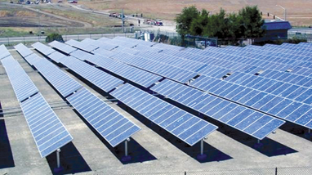
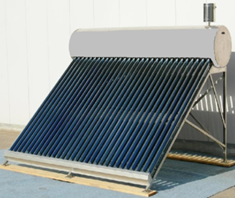
THERE ARE TWO TYPES OF SOLAR PANELS
SOLAR PHOTOVOLTAIC SYSTEM WHICH PRODUCE ELECTRCITY
THHERMAL SYSTEM WHICH PRODUCE HOT WATER

Slide 3
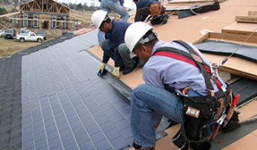
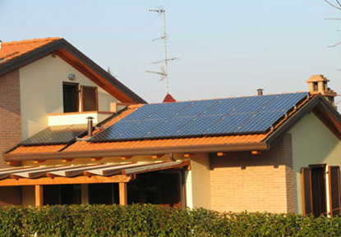
THE PANELS ARE PUT ON
THE ROOF OR ON A WALL
STEP 1
STEP 2

Slide 4
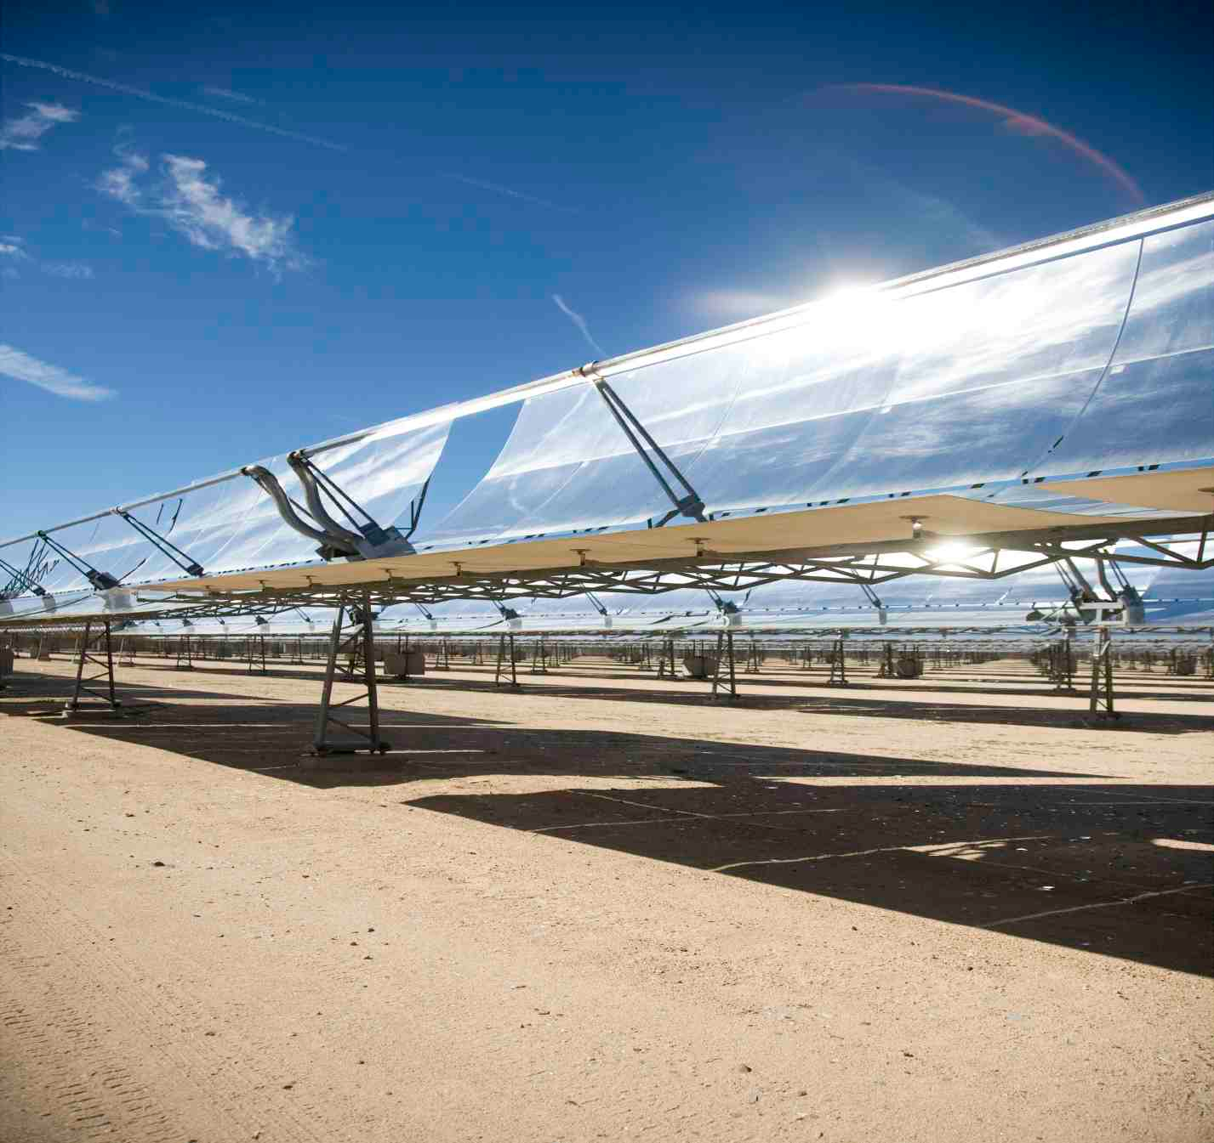
CONCENTARTING SOLAR
POWER (CSP)
THE CSP PRODUCE HEAT
BY THAT SOLAR PANELS
ADVANCED

Slide 5
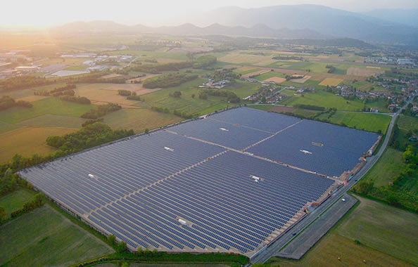
FINISH
THANKS FOR WATCHING
By : Giovanni Iodice Va

